Slide 1
E-bay - E-commerce Website
Under Guidance of Mrs. Vaishali Sonanis Mam.

Slide 2
Introduction :
eBay is a global e-commerce platform that allows individuals and businesses to buy and sell goods and services worldwide. The site provides a marketplace with vast product categories and various buying options.
In this project, I tested eBay’s main features and user interface, checking how real users would interact with the platform to make sure it works smoothly and is easy to use.

Slide 3
Responsibilities
Create Test plan.
Create Automated testcases in TestNG framework.
Execute all the test cases.
Create defect report.

Slide 4
Overview
What is E-bay?
eBay is an online marketplace where people can buy and sell both new and used items in many categories. It allows sales between individual users as well as businesses and customers, with secure payment options and buyer protection.

Slide 5
Modules
Module 1 : Login page
Make sure a user can sign in with correct username and password and reach their main page.
Module 2 : multiple search
Checked if Automated searches for different products like laptop, watch, phone, and headphones are displayed
Module 3 : Add to cart page
Make sure clicking “Add to Cart” puts the item in your shopping cart and updates the number of items in cart.
Notes:
Module 1: Signn in page
Checked all the functionalities on Sign in page which included personal info as email
address, password
Module 2: Women page
Checked all the functionalities on Women page which included item details, Quantity, Filters,compare button,Add to cart button,product info,grid,list button
Module 3: Tshirt page
Checked all the functionalities on T-Shirt page which included item details, Quantity, Filters,compare button,Add to cart button,product info,grid,list button
Module 4: All Buttons and Drop Down Arrow :
team checked if all the buttons and drop down arrows of different fields are functioning properly or not

Slide 6
Module 4 : delete from cart
Make sure you can remove product from the cart and the cart shows as empty when item is deleted.
Module 5 : shop by categories
Make sure clicking on any category (like Electronics or Fashion) shows a list of products from that category.
Module 6 : get product description
Check that when you open any product page, you can see a clear and correct description of the item.
Module 7 : language select
Make sure users can select their country, and the website updates menus and text to the appropriate language for that region.

Slide 7
Module 8 : shop by all categories
Check that clicking “Shop by All Categories” shows a complete list of every product category on the site and by clicking on them should take us to their respective page.
Module 9 : change username
Verify users can update their username in account settings and see the new name across the website.
Module 10 : change user address
Make sure users can enter a new shipping address and it gets saved and used for future orders.

Slide 8
Defects
During testing of the eBay homepage, I observed that certain key elements related to live events and sales are not functioning as expected. Specifically, the absence of navigation tools and interactive filters, as well as the lack of product thumbnails for listings, significantly degrade the user experience.
These issues prevent users from easily discovering and engaging with promotional content, representing critical defects in the frontend user interface

Slide 9
Defect identifier :- E-Bay_001
Defect summary :- E-bay live shows long list of live events headlines without navigation, categories and filters
Ø Test Id :- TC_001
Ø Test case name :- TC_ No_ live events_ navigation
Ø Module name :- homepage – live events
Ø Reproducible :- yes
Ø Severity :- Medium
Ø Priority :- critical
Ø Raised by :- Sai Bavesh
Ø Assigned to :- developer Team
Ø Date of assignment :-
Ø Status :- pending
Ø Snap shots :-
Ø Fixed by :- developer
Ø Date of fixing :-

Slide 10
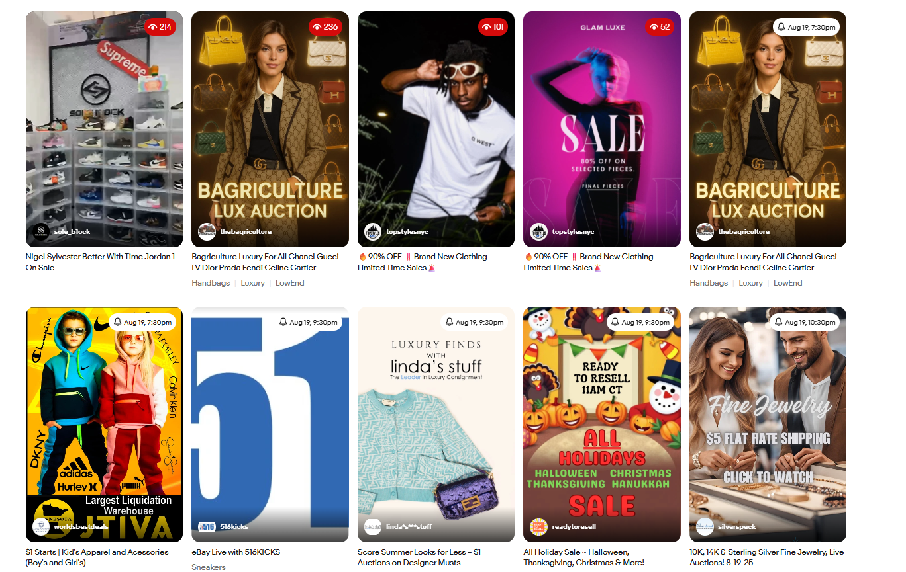

Slide 11
Defect identifier :- E-bay_002
Ø Defect summary :- Only textual information is displayed for categories and listings. No product or category images/thumbnails appear and when selected give 0 results
Ø Test Id :- TC_002
Ø Test case name :- TC_ Categories_ Thumbnails_ and Products Missing
Ø Module name :- Homepage - collectables and art Section
Ø Reproducible :- yes
Ø Severity :- Medium
Ø Priority :- High
Ø Raised by :- Sai Bavesh
Ø Assigned to :- developer Team
Ø Date of assignment :-
Ø Status :- pending
Ø Snap shots :-
Ø Fixed by :- developer
Ø Date of fixing :-

Slide 12
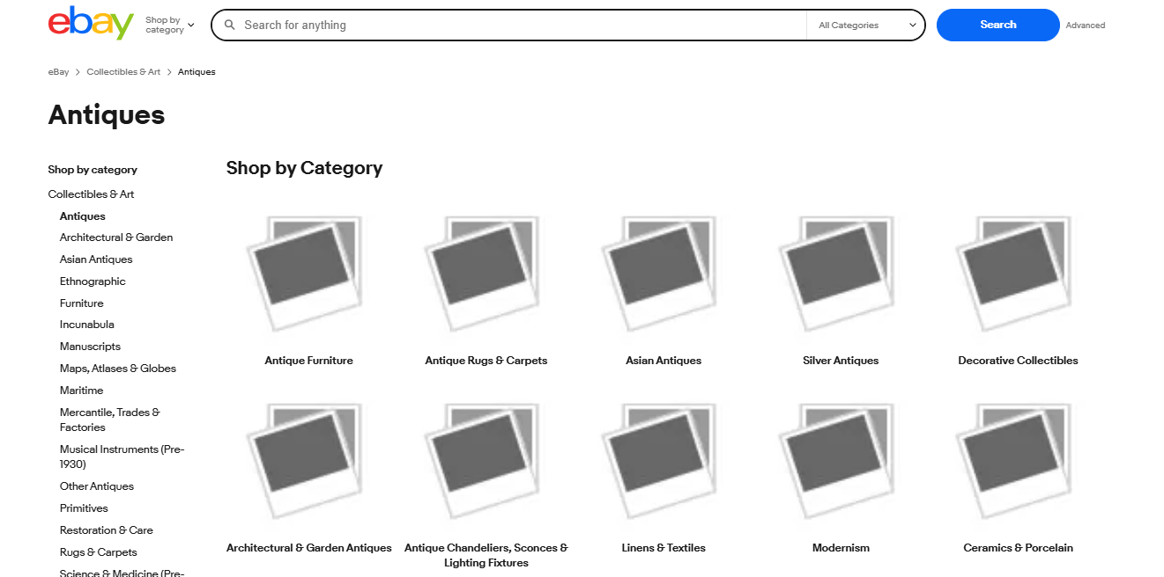

Slide 13
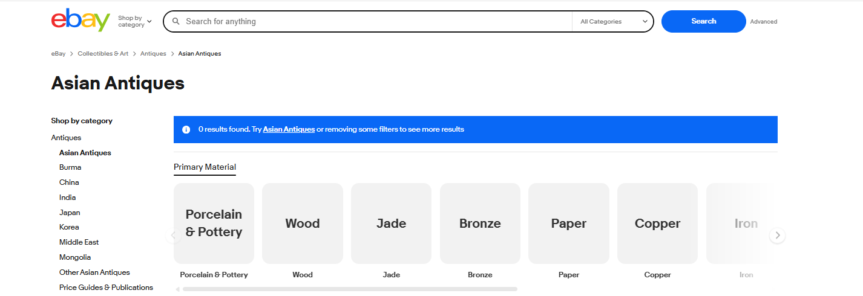

Slide 14
Challenges
While testing big website which contains huge data we faced some challenges about:
Choosing the right locator for each element can be confusing at times.
Sometimes, when executing all test cases at once, synchronization issues caused the automation to pause or fail before finishing.
Doing all the test cases took time and needed a lot of focus to make sure everything was done right.

Slide 15
Experience
Learned how to design and follow a complete testing process for an online shopping website.
Gained hands- on experience on how to find out bugs manually, how to use Selenium web driver to automate tasks on eBay’s website and how to use TestNG Framework to arrange tests in groups and make running them easier
Get to know Manual testing needs strong observation and testers needs to apply all possibilities in test cases.

Slide 16
Thank You!!!
Vaishali Mam For Guiding Us through out the Project.

